Slide 1
Testing Strategy for
Campsited Web Frontend Function

Slide 2
Agenda
General Web Testing Guidance
Strategy for Campsited Web Testing
“Selenium + Python” Solution
Work Plan and Schedule

Slide 3
Agenda
General Web Testing Guidance
Strategy for Campsited Web Testing
“Selenium + Python” Solution
Work Plan and Schedule

Slide 4


General Web Testing Guidance
1
Functional Testing
All links, All forms, Cookies, HTML/CSS, Databases, etc.
Smoke testing, Integration, Regression
2
Browser based
Operation Environment based
Device based
Compatibility Testing
3
Floorplan
Text info, Font, All Fields (TextBox, Dropdown, Button, Bar, Tab)
Useful/Findable/Accessible/Usable/Desirable
Usability Testing
4
Speed
Scalability
Stability
Performance Testing
5
Security Testing
URL Operation/ID Authentication
Web server/application Protection and Identification

Slide 5
Agenda
General Web Testing Guidance
Strategy for Campsited Web Testing
“Selenium + Python” Solution
Work Plan and Schedule

Slide 6

Strategy for Campsited Web Testing -- Overview
Functional Testing
Compatibility Testing
Usability Testing
Performance Testing
Security Testing
High
Coverage
Full
Automation
Regular Regression
Notes: currently “Security Testing” will be waived temporarily compared with others

Slide 7
Strategy for Campsited Web Testing – Functional Testing
Purpose
Verify whether website meets the intended functional specifications mentioned in development tickets.
Identify Test Input
Prepare expected outcomes (GOLDEN)
Execute test cases
Output target results
Comparison
Testing Scope
Major Pages:
Home Page
Results Page
Details Page
Booking Page
Major Actions:
Search
Filter
Sort
Check
View
Book
Major Elements:
Link
Form
Menu
Formatted-Info

Slide 8
Strategy for Campsited Web Testing – Functional Testing (Cont.)
Pass/Fail Criteria --- Based On Actions
Major Actions | Pass/Fail Criteria | Comments
Search Campsites | The campsite number got matched with golden exactly | From Home Page From Results Page Based on different country/region/town/department and specific campsites
Filter Campsites | The campsite number matched with golden exactly | Go through each factors Random combination
Sort Campsites | The campsite sequence matched with golden exactly | Golden should be refreshed regularly
Check Campsites | Primary image should be the same Detailed text info should be the same | Based on different pages and entries
Check Availability | Results can be shown smoothly | No fixed golden can be leveraged Cover all of options
View details | Detailed text info should be the same | N/A
Book Campsites | Whole flow can be done well | N/A

Slide 9
Strategy for Campsited Web Testing – Functional Testing (Cont.)
Pass/Fail Criteria --- Based On Elements
Major Elements | Pass/Fail Criteria | Comments
Link | No broken for any links Destination of link matches golden | External/Internal/anchored links Email related links
Field | Valid output (matches with golden) should be got with valid input Error/Warning Msg should be issued for invalid input | Field related to search/check function Field related to booking flow
Menu | Menu info matches the golden Functionality matches the golden | Menu related to Country, Theme, campsite details, etc. Menu related to filter/sort function
Existence
Correctness
Consistence

Slide 10
Strategy for Campsited Web Testing – Functional Testing (Cont.)
Checkboard --- Home Page Based
Element | Link | Field | Menu | Formatted-Info
Header | P0 | N/A | N/A | N/A
Hero Area | P0 | P0 | P1 | N/A
Top Campsite Picks | P0 | N/A | N/A | P1
Countries | P0 | N/A | N/A | P1
Themes | P0 | N/A | P1 | P1
Newsletter | P0 | P0 | N/A | N/A
Footer | P0 | N/A | N/A | N/A
Notes: “P0” means high priority

Slide 11
Strategy for Campsited Web Testing – Functional Testing (Cont.)
Checkboard --- Results Page Based
Element | Link | Field | Menu | Formatted-Info
Header | P0 | N/A | N/A | N/A
Function Bar | P0 | P0 | P1 | N/A
Results | P0 | N/A | N/A | P1
Map | P0 | N/A | N/A | P1
Footer | P0 | N/A | N/A | N/A
Notes: “P0” means high priority

Slide 12
Strategy for Campsited Web Testing – Functional Testing (Cont.)
Checkboard --- Details Page Based
Element | Link | Field | Menu | Formatted-Info
Header | P0 | N/A | N/A | N/A
Sticky Nav | P0 | P0 | P1 | P1
Share Modal | P0 | N/A | N/A | N/A
Hero Area | P0 | N/A | N/A | P1
Overview | P0 | N/A | N/A | P1
Availability Form | P0 | P0 | P1 | P1
Sticky Enquiry Form | P0 | P0 | N/A | N/A
Activities and Facilities | N/A | N/A | P1 | P1
Reviews | P0 | N/A | N/A | P1
Notes: “P0” means high priority

Slide 13
Strategy for Campsited Web Testing – Functional Testing (Cont.)
Checkboard --- Details Page Based (Cont.)
Element | Link | Field | Menu | Formatted-Info
Booking Information | P0 | N/A | N/A | P1
Accommodations | P0 | N/A | N/A | P1
Enquiry | P0 | P0 | N/A | N/A
Location | P0 | N/A | N/A | P1
Policies | P0 | P0 | P1 | N/A
Nearby Campsites | P0 | N/A | N/A | P1
Newsletter | P0 | P0 | N/A | N/A
Footer | P0 | N/A | N/A | N/A
Notes: “P0” means high priority

Slide 14
Strategy for Campsited Web Testing – Functional Testing (Cont.)
Checkboard --- Booking Page Based
Element | Link | Field | Menu | Formatted-Info
Header | P0 | N/A | N/A | N/A
S1: Optional extras | P0 | P0 | N/A | P0
S2: Your details | P0 | P0 | P0 | P0
S3: Confirm and pay | P0 | P0 | P0 | P0
Footer | P0 | N/A | N/A | N/A
Booking Panel | P0 | N/A | P0 | P0
Balance and Cancellation links | P0 | N/A | N/A | N/A
Notes: “P0” means high priority

Slide 15
Strategy for Campsited Web Testing – Functional Testing (Cont.)
Checkboard --- User Model Based
How to find Campsites
How to check and view Availability
How to book
From different entries
From different type of searches
From different preferences
Multiple iterations
From different entries
Detailed info of specific campsite and Accommodation
Date refinement within two weeks
Step 1 --- Optional extras
Step 2 --- Your details
Step 3 --- Confirm and pay

Slide 16

Strategy for Campsited Web Testing – Compatibility Testing
Browser
Device
IE
Firefox
Chrome
Safari
Opera
Desktop
Tablet
Mobile
Do Combination
Keep Consistence
Operation System
Backward
Compatibility
Windows
Android
iOS

Slide 17
Strategy for Campsited Web Testing – Usability Testing
Desirable
Useful
Findable
Accessible
Desirable
Usable
Desirable
How-to-do:
Manual testing to clean up golden web page based on specification
Make auto comparison for web page snapshot between golden and target

Slide 18
Strategy for Campsited Web Testing – Performance Testing
Identify Test Environment
Speed
Desirable
Finalize Performance Criteria
Scalability
Desirable
Run Tests
Analysis and Retest
Stability
Desirable

Slide 19
Agenda
General Web Testing Guidance
Strategy for Campsited Web Testing
“Selenium + Python” Solution
Work Plan and Schedule

Slide 20
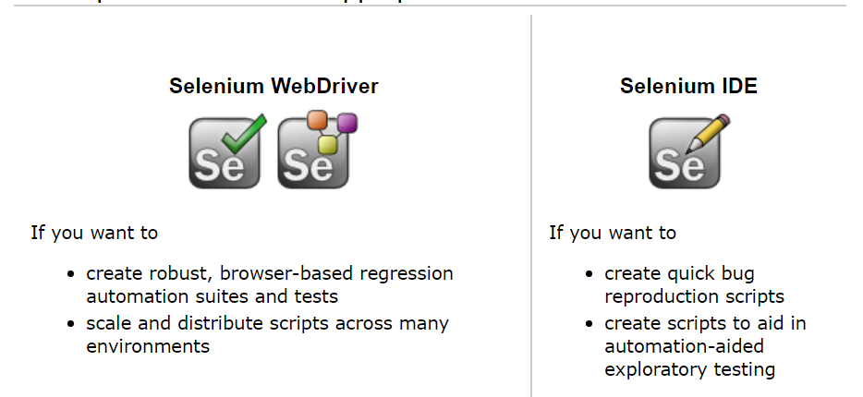
“Selenium + Python” Solution --- Overview
Key Features
Automates Browser
Automating web applications for testing purposes
Supported by major browser vendors (IE, Chrome, Firefox, etc.)

Slide 21
“Selenium + Python” Solution --- Test Process
Smoke
Testing
Unit level testing during development stage
Address each behavior change in tickets
Integration
Integrate smoke testing into flow level validation
Full coverage for all of user models published
Regression
Build test suites aligned with customized priorities
Regular launch, review, escalation and upgrade

Slide 22
“Selenium + Python” Solution --- Test Process (Cont.)
Examples for check points
Flow Steps
Smoke Testing
Integration
Home Page Access
Check page title info
Check hero area title info
Check themes’ info
Check links in header and footer
Make suite for checking
all of links and information
Check the function of search bar
Check the function of countries
Check the function of themes
Combine all of entries of
searching and check final
results’ correctness and
consistence
Search campsites in specific area
Build a
whole flow to book a campsite from beginning to end
Do results refresh in Results Page
Check the function of Filter
Check the function of Sort
Filter-factor combination
Specific suite for sort
function correctness
Check the function of availability bar
Check each section of campsite
Check accommodation details
Check availability and request book
Check the function of
“View availability” and
“Check availability”
Check availability in Details Page
Request book
Check each filed in each step
Go through all steps to final

Slide 23
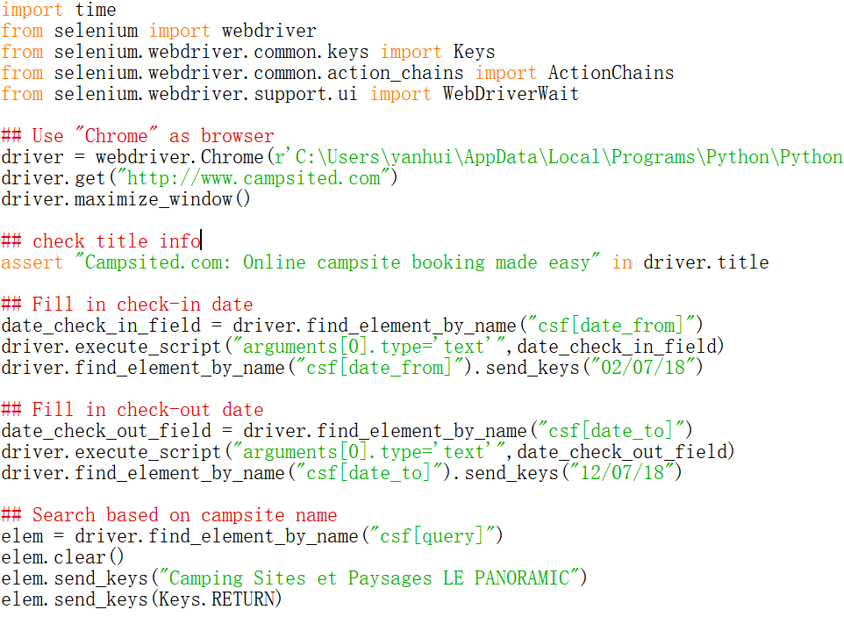
“Selenium + Python” Solution --- Test Process (Cont.)
Examples for code implementation
Based on “Chrome + Home Page + Campsite Name” to do search

Slide 24
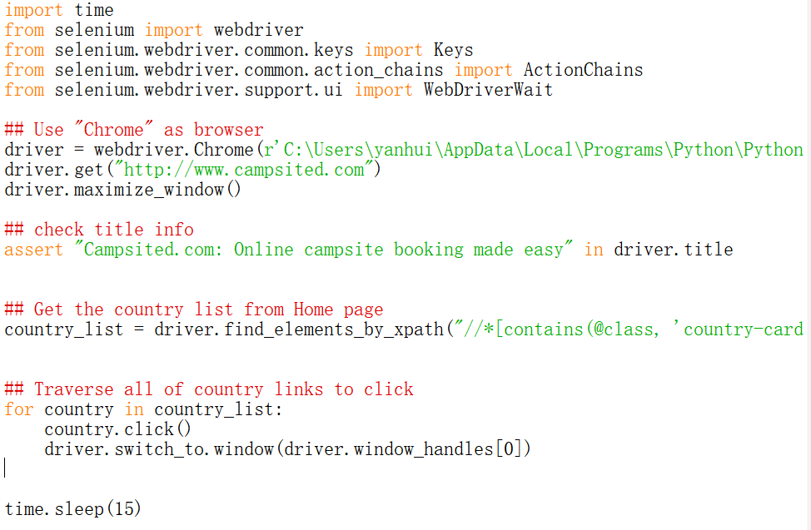
“Selenium + Python” Solution --- Test Process (Cont.)
Examples for code implementation (Cont.)
Based on “Chrome + Home Page” to traverse all of country links

Slide 25
“Selenium + Python” Solution --- Regression
Regression System Snapshot
One-button solution ideally
The few manual work, the better
Desirable
Test Suite
Generation
Auto
Launch
Auto
Review
Ticket
Test Suite
Refreshment
Auto
Signoff and Archive
Identification and Escalation

Slide 26
“Selenium + Python” Solution --- Regression
Regression System Key Ideas
Test Suite Generation
Tickets based
User Models based
Customer issues based
Auto Launch, Review and Signoff
One-button solution for launch whole regression
Final results are summarized on dashboard and categorized with severity priority
Signoff will be made based on running results
Keep high frequency to launch the system daily
Issues identification and Escalation
Identify issues manually shows on the dashboard with priority list
Escalate gating issue in time to the team and build tracker to push fixing
All of issues should be addressed well in dashboard
Test Suite Refreshment
Root Case Analysis (RCA) regularly and share with team
RCA-oriented test suite refreshment to add new test case to improve coverage
Retirement for old test case without any failures for long time if necessary

Slide 27
Agenda
General Web Testing Guidance
Strategy for Campsited Web Testing
“Selenium + Python” Solution
Work Plan and Schedule

Slide 28
Work Plan and Schedule
Category | Specific Items | Timeline
Regression System Architecture | Focus on detailed specification | 05/07/2018
 | Define Major structure, user model and internal interface, then implement them | 10/07/2018
Functional Testing | Search Functions | 20/07/2018
 | Filter & Sort Functions | 30/07/2018
 | Check & View Availability | 05/08/2018
 | Integration for whole booking flow | 15/08/2018
Compatibility Testing | Combinations with “browser + OS + platform” | 25/08/2018
Usability Testing | N/A | 30/08/2018
Performance Testing | N/A | 10/09/2018

Slide 29
THANKS

